Slide 1
Words of Silver

Slide 2
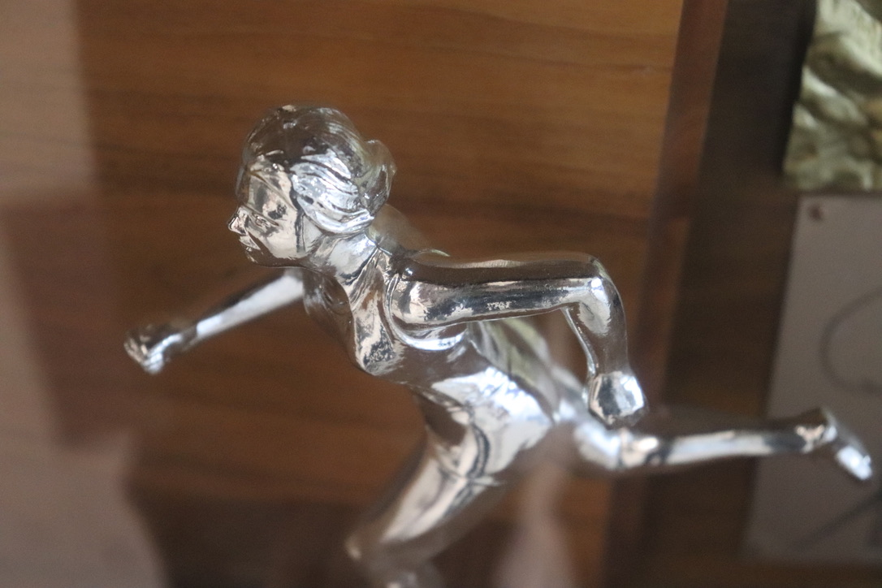
,
Dark clouds abound here,
But the attention is on
Their silver linings

Slide 3
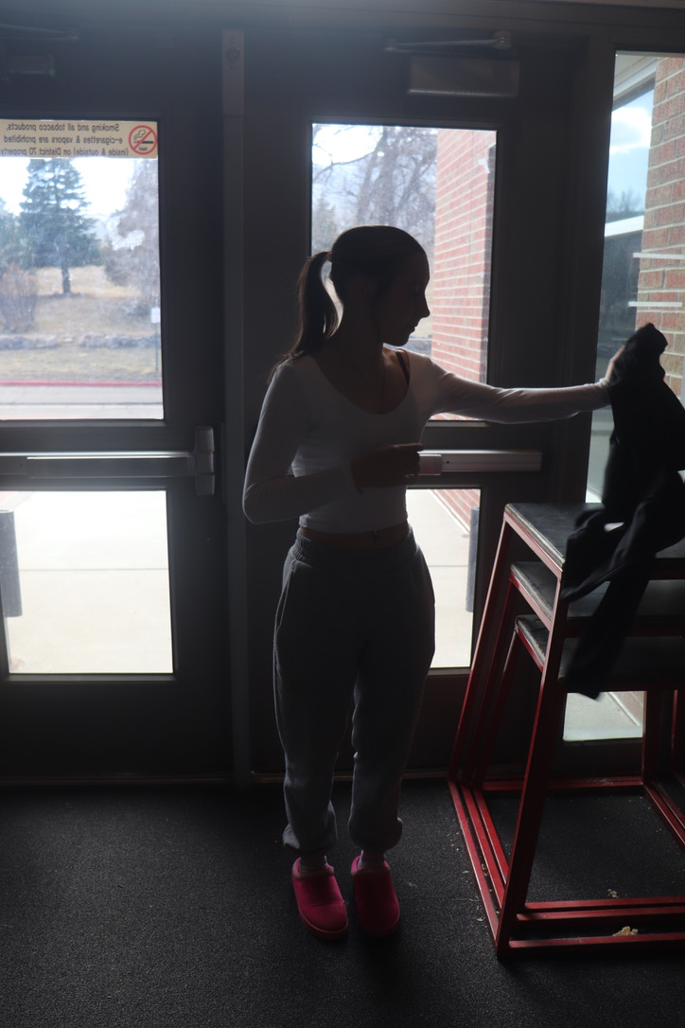
,
Language, charged,
Slyly commands feeling;
Escapes detection

Slide 4
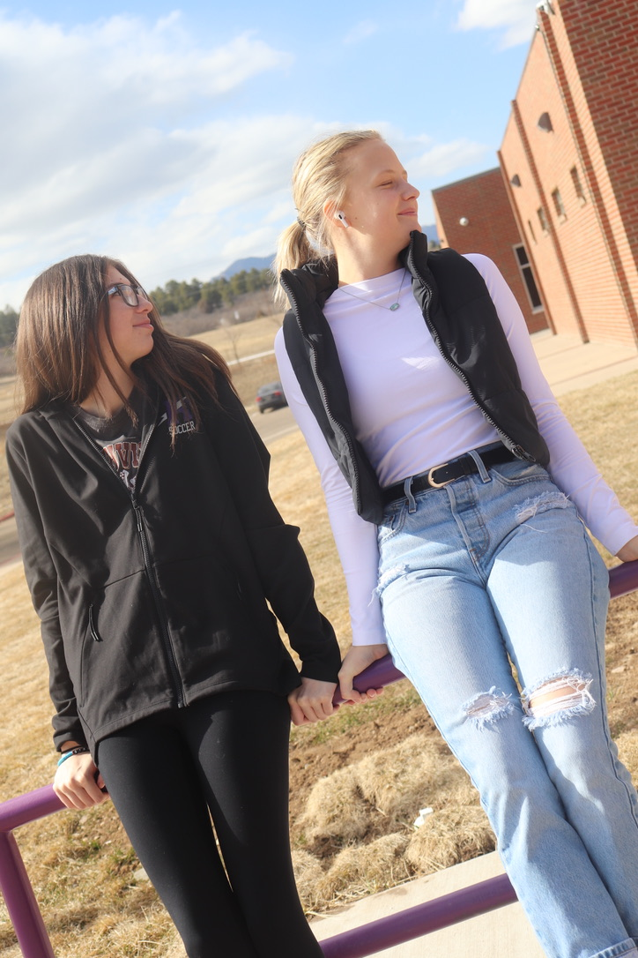
,
For example:
Every “they” has a name;
Every “should,” a will

Slide 5
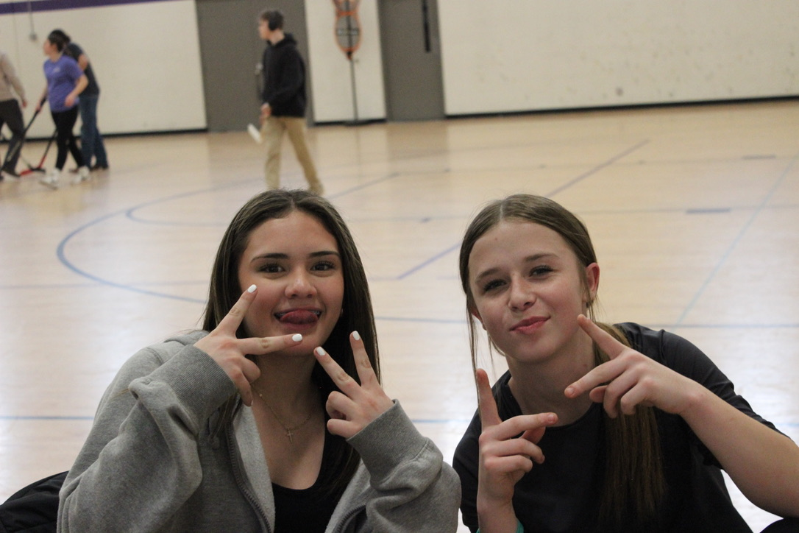
,
Words, I live by
For life is best lived
With others

Slide 6
The End

